Slide 1
Queryable map events of IIITH
By sunand Puli

Slide 2
Need for Event locations online on map?
To Provide visitors about information of events and event locations.
To provide them an easy way of finding places and find route to their desired location from their desired location.
For students who are lazy to check mails they can easily query event of their desired date.

Slide 3
Scope
To analyse events location in IIIT H .
A easiest way to manage events.
Can be extended to a larger networks.

Slide 4
Objective
This project aims at providing a user a detailed structured information about event, their timing and location.
This project provides a easiest interface to manage events.

Slide 5
Data Required
Map Data of IIIT-H
Event Data
Photos of buildings in IIIT-H

Slide 6
Key feature
Extracting information about a place/building.​
Exploring various events in the campus and their locations.​
Finding the route to different places in the campus/outside side

Slide 7
Key Concepts
Map visualization.
Routing.
Query processing.
Database management.

Slide 8
Map Visualization

Slide 9
Technologies
MapBox API
Leaflet API
HTML,CSS
Javascript
PHP

Slide 10
Procedure
The admin will be given map he needs to select the building vertices and then store them.
Then he can use the vertices to make polygon and then can select the location by checking point in polygon.

Slide 11
Challenges involved
He should get the latitudes and longitudes of vertices.
He should store the latitudes and longitudes and then make polygons out of them.
He should set the zoom parameter of the map to visualize a particular area completely with all its elements being visible.

Slide 12
Routing

Slide 13
Technologies
Javascript
html

Slide 14
Procedure
The user is given to select the start and destination points in the map between which he wants to find the route.
The start and end points are given markers when he selects the points.
Once you select and click submit we can find the route between the points.

Slide 15
Challenges involved
Once the source and destination is selected we need to find the points at which we should take turn.
After we get the points at which we should take turn we need to draw google polyline between those points.

Slide 16
Database management and Query Processing

Slide 17
Technologies
mysql Database
phpmyadmin
Javascript
PHP

Slide 18
Procedure
Admin needs to insert event data from the map.
Then we should store the event data in sql database.
Then when the user gives what he need we will query the database and gives the user output.

Slide 19
Challenges involved
We need to connect to phpmyadmin and select database without any connection error.
We need to check if the data is inserting correctly to the database or any error occured.

Slide 20
USER INTERFACE

Slide 21
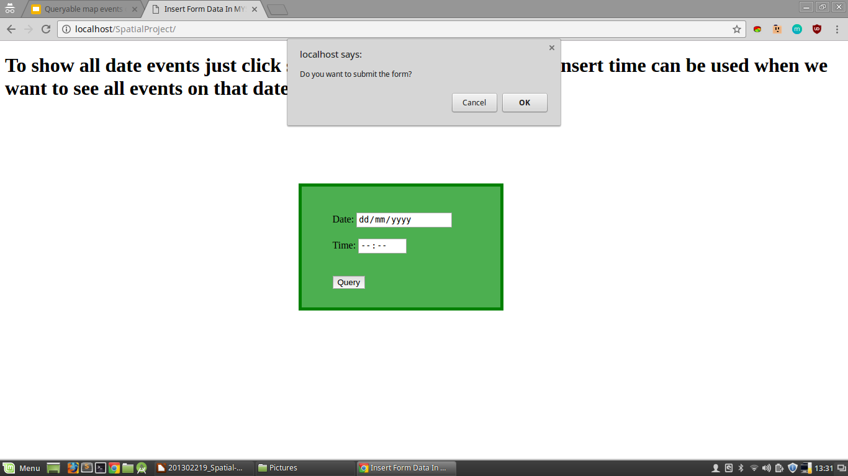

Slide 22
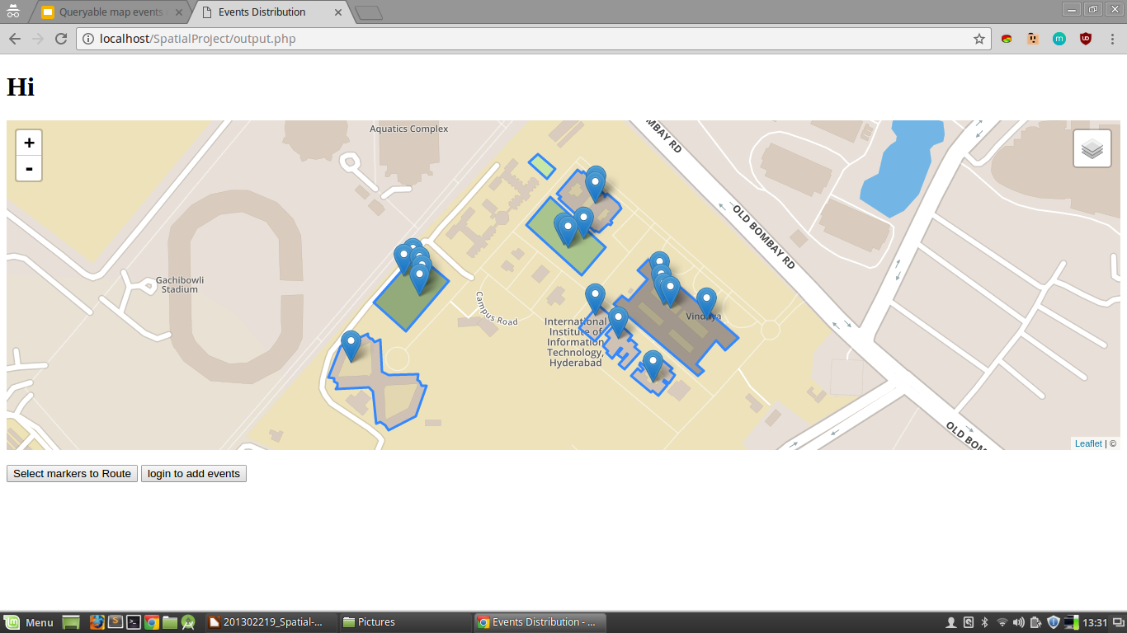

Slide 23
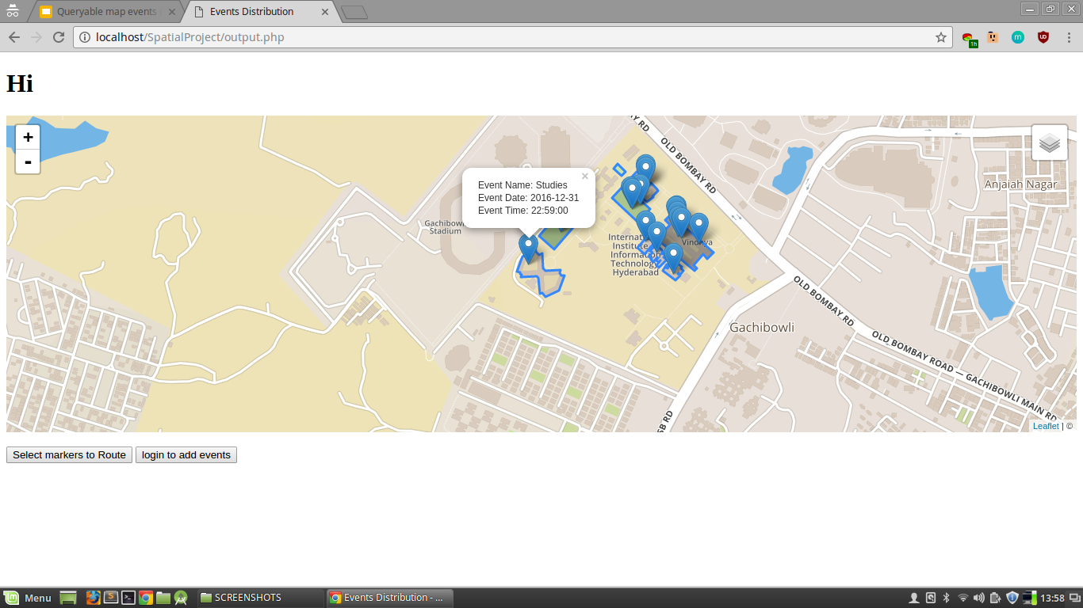

Slide 24


Slide 25
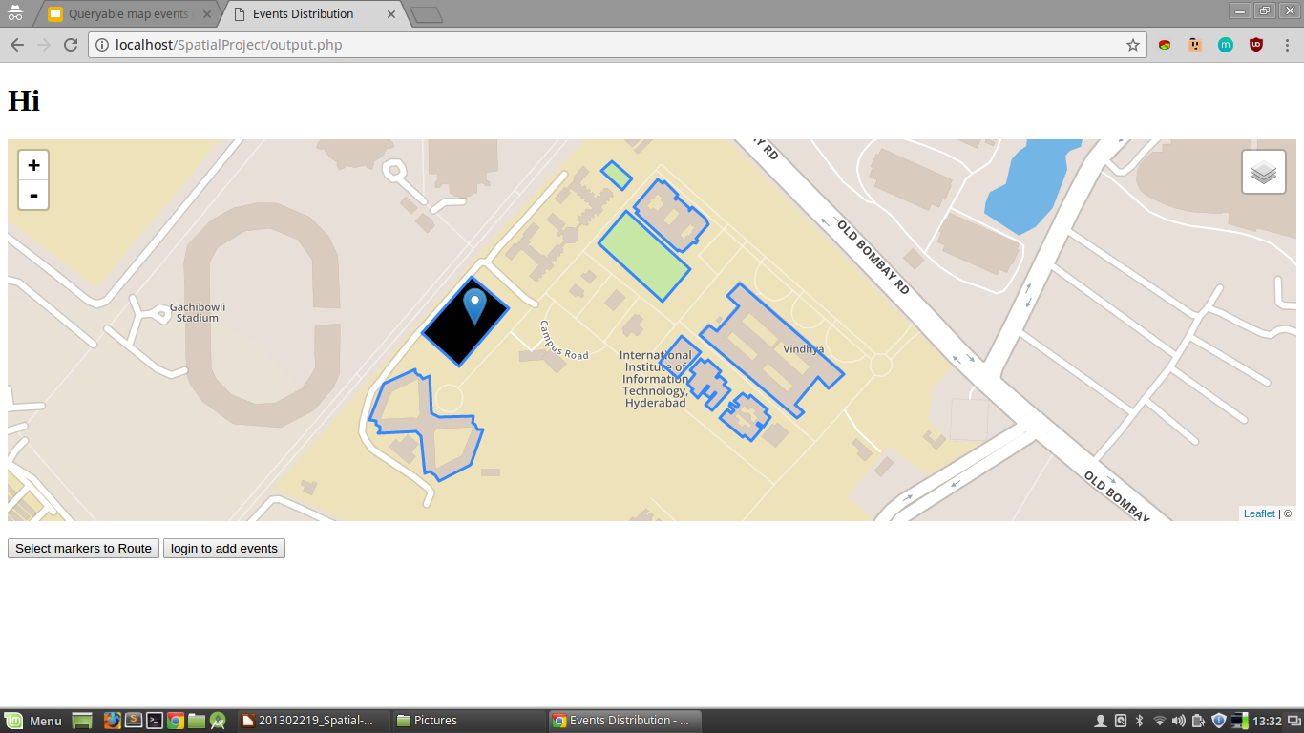

Slide 26
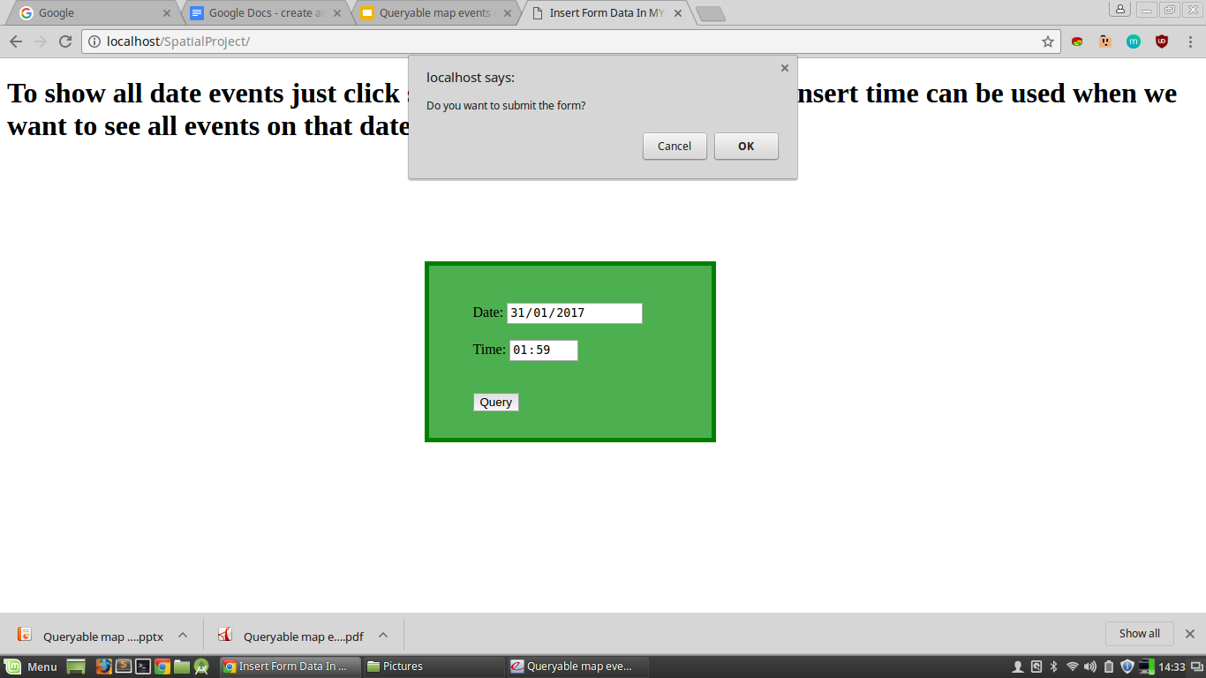

Slide 27
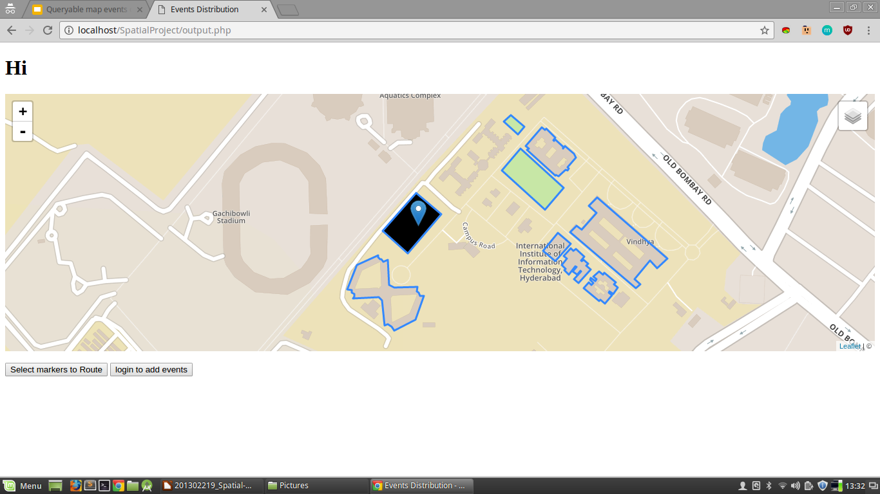

Slide 28
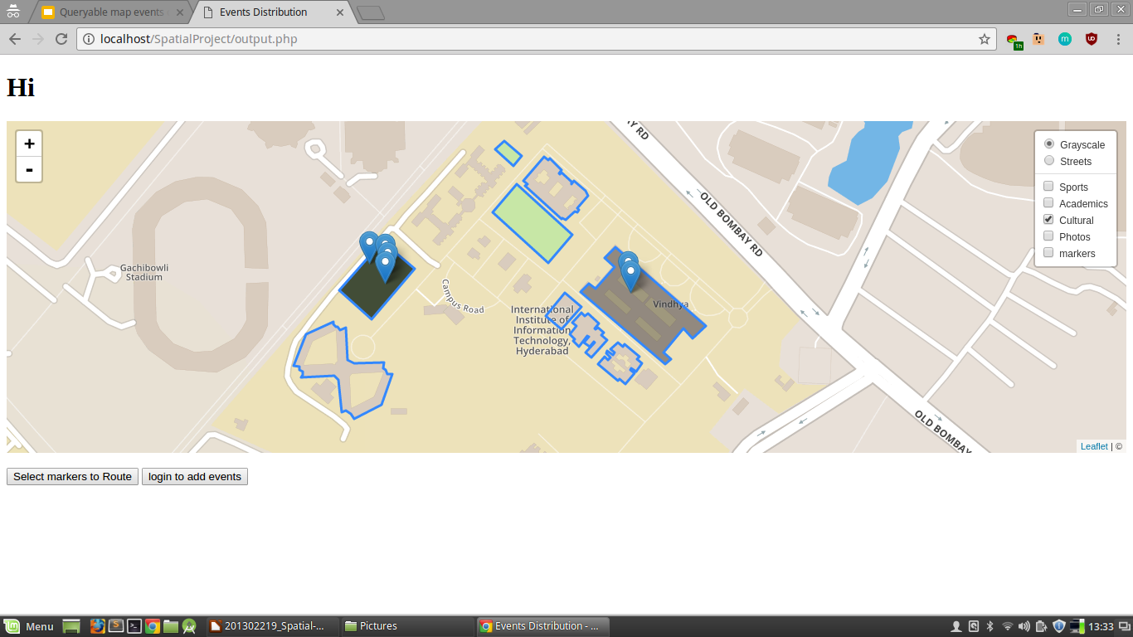

Slide 29
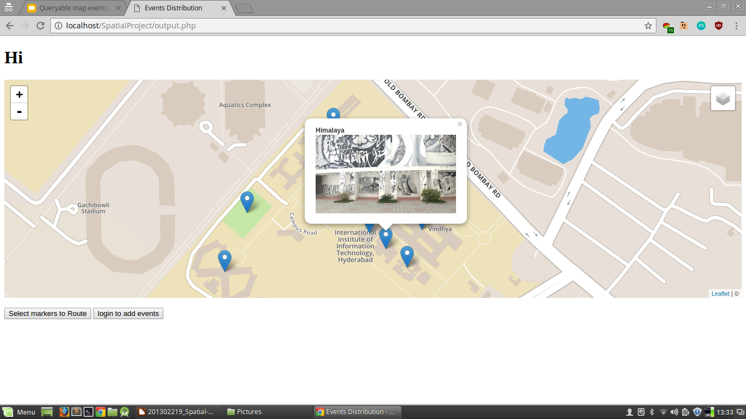

Slide 30
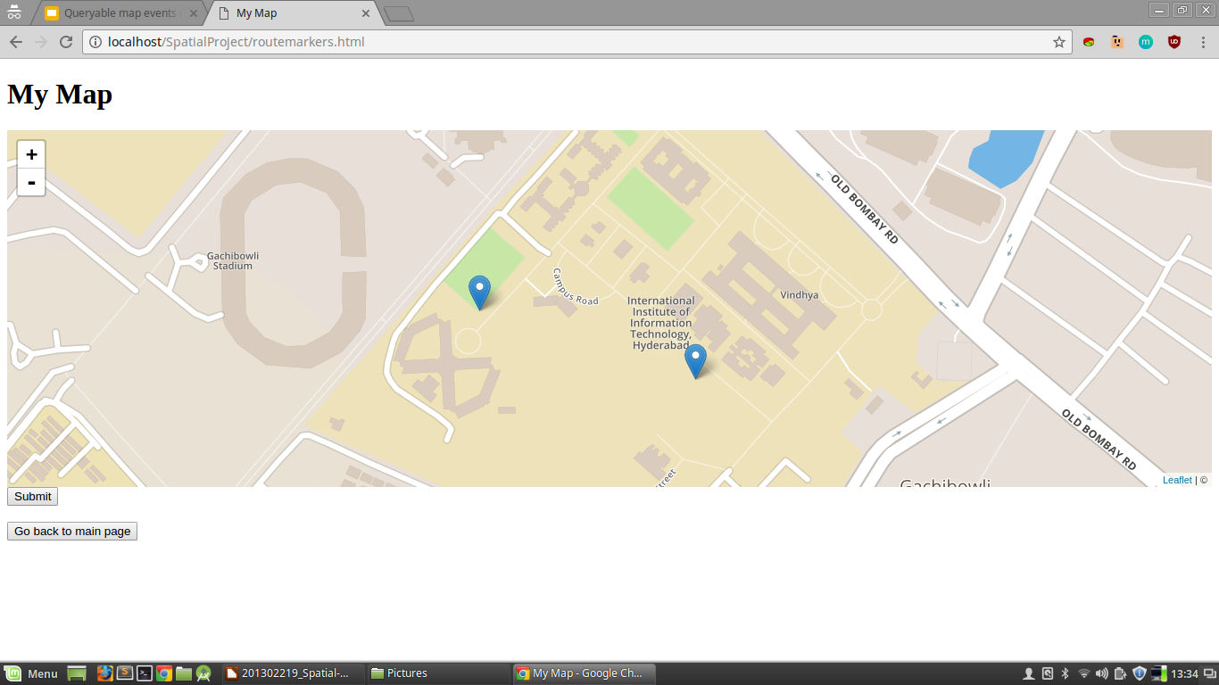

Slide 31
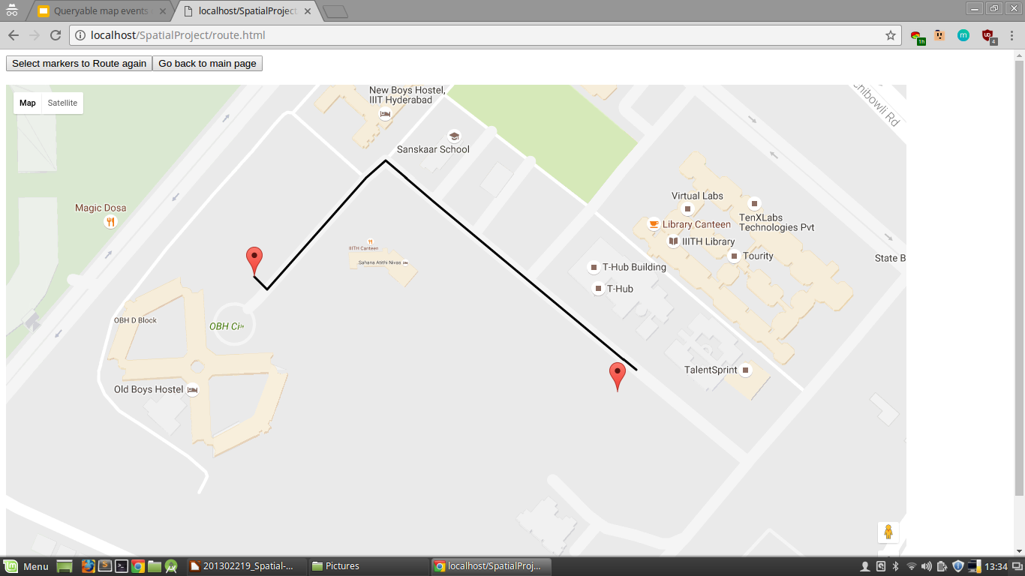

Slide 32
ADMIN INTERFACE

Slide 33
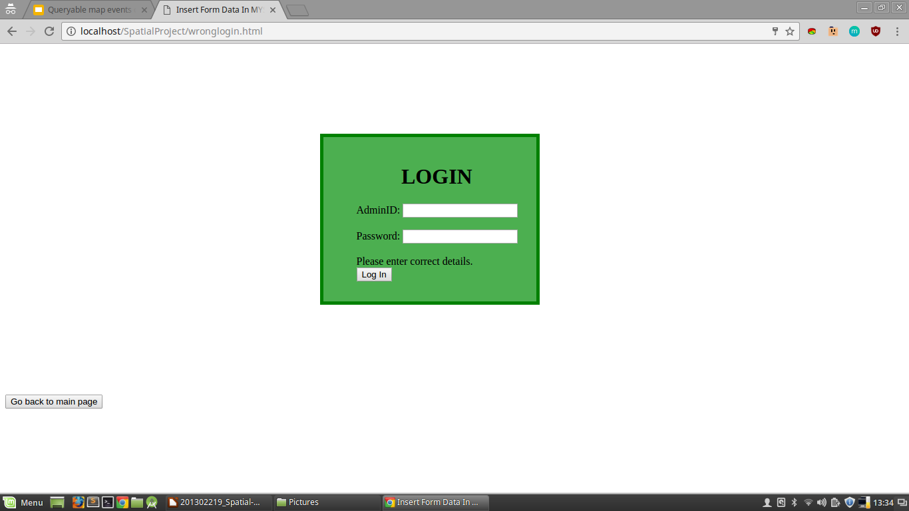

Slide 34
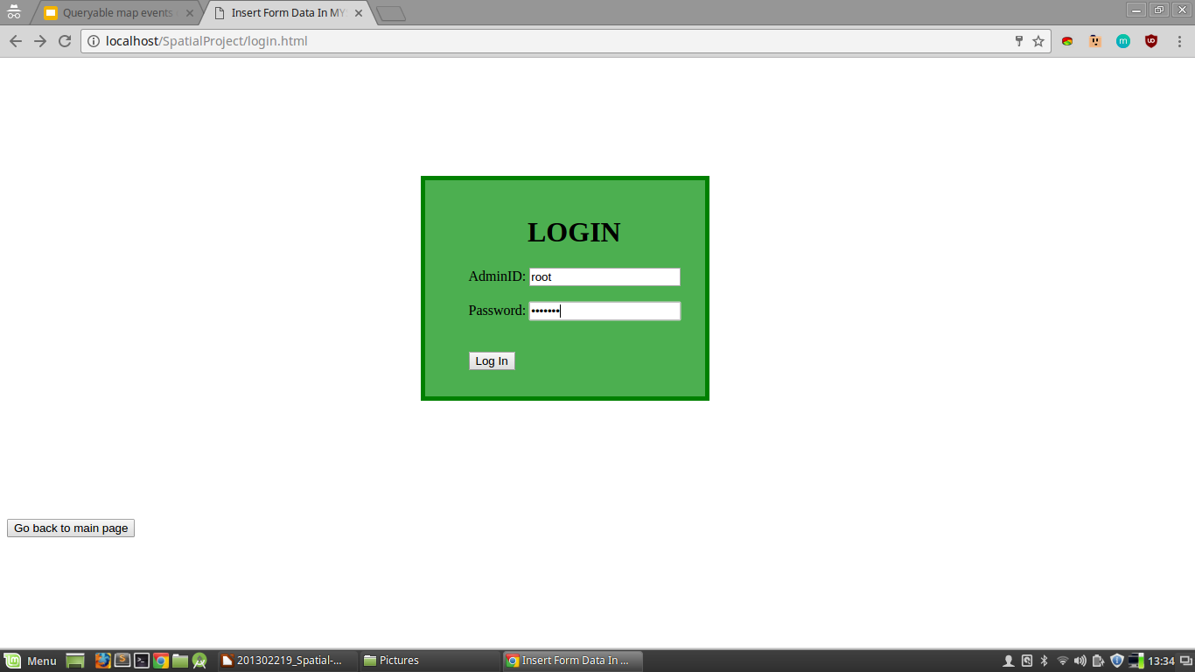

Slide 35
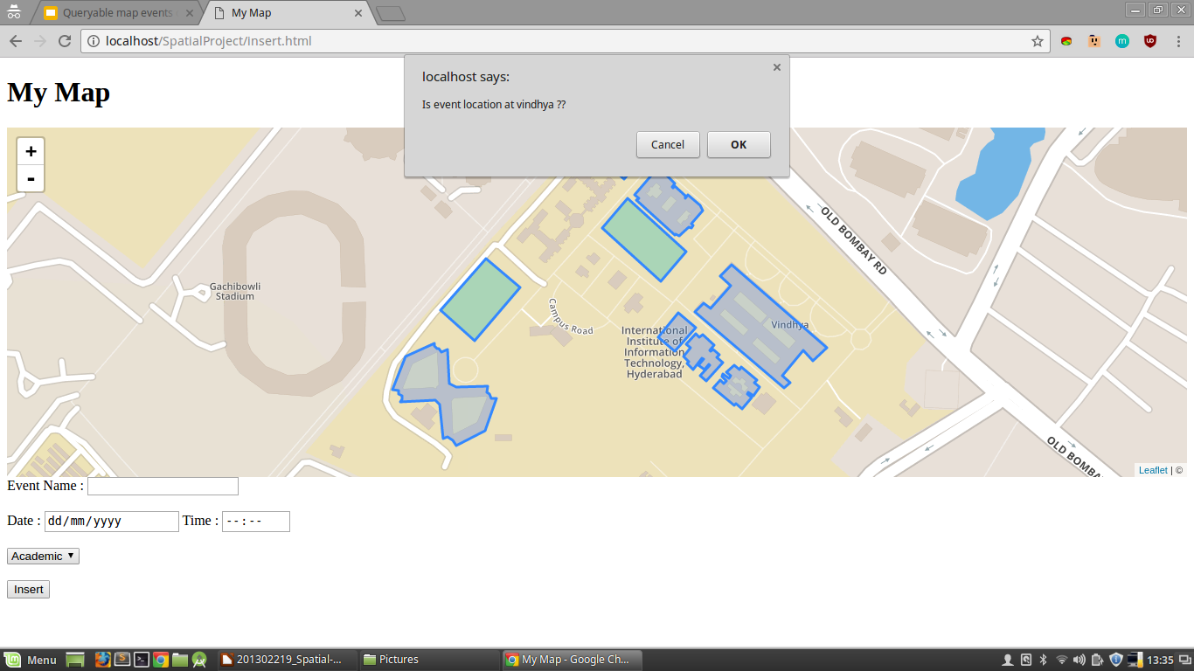

Slide 36
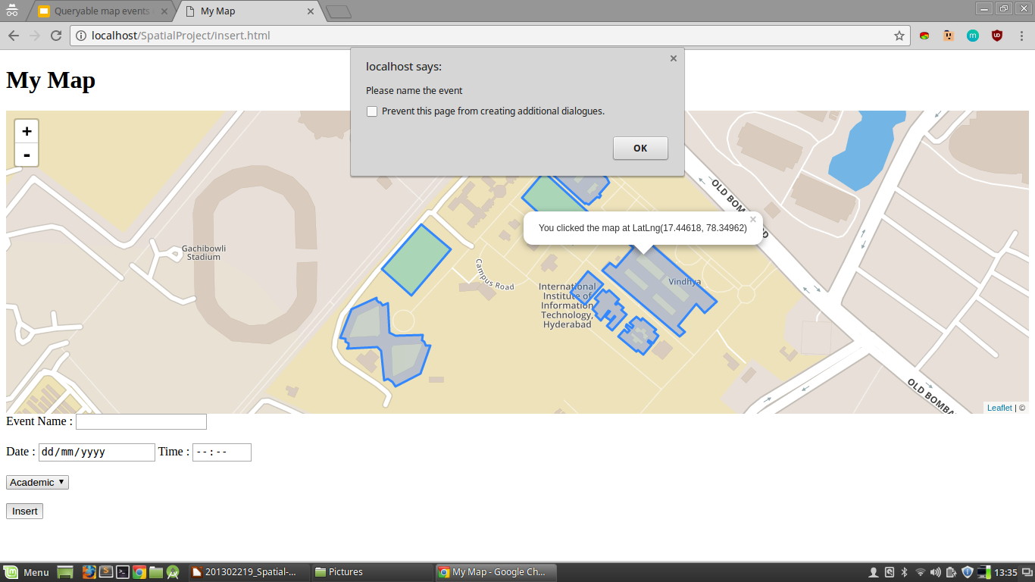

Slide 37
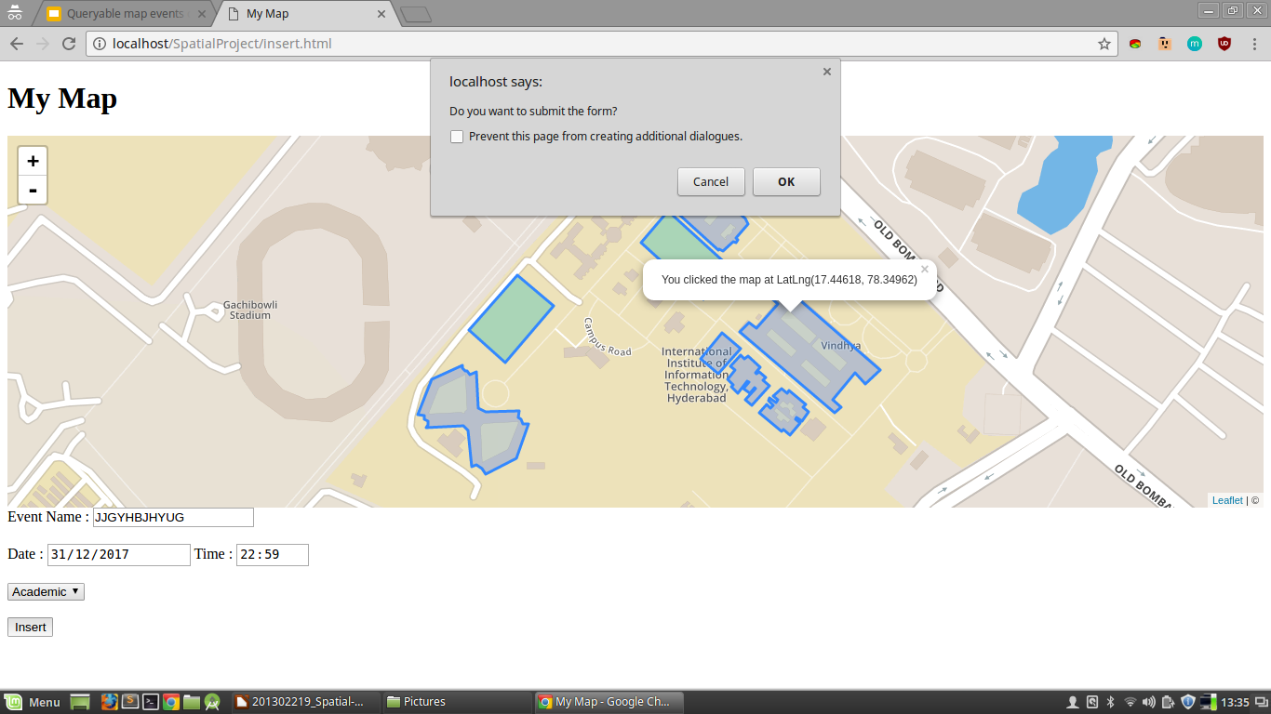

Slide 38
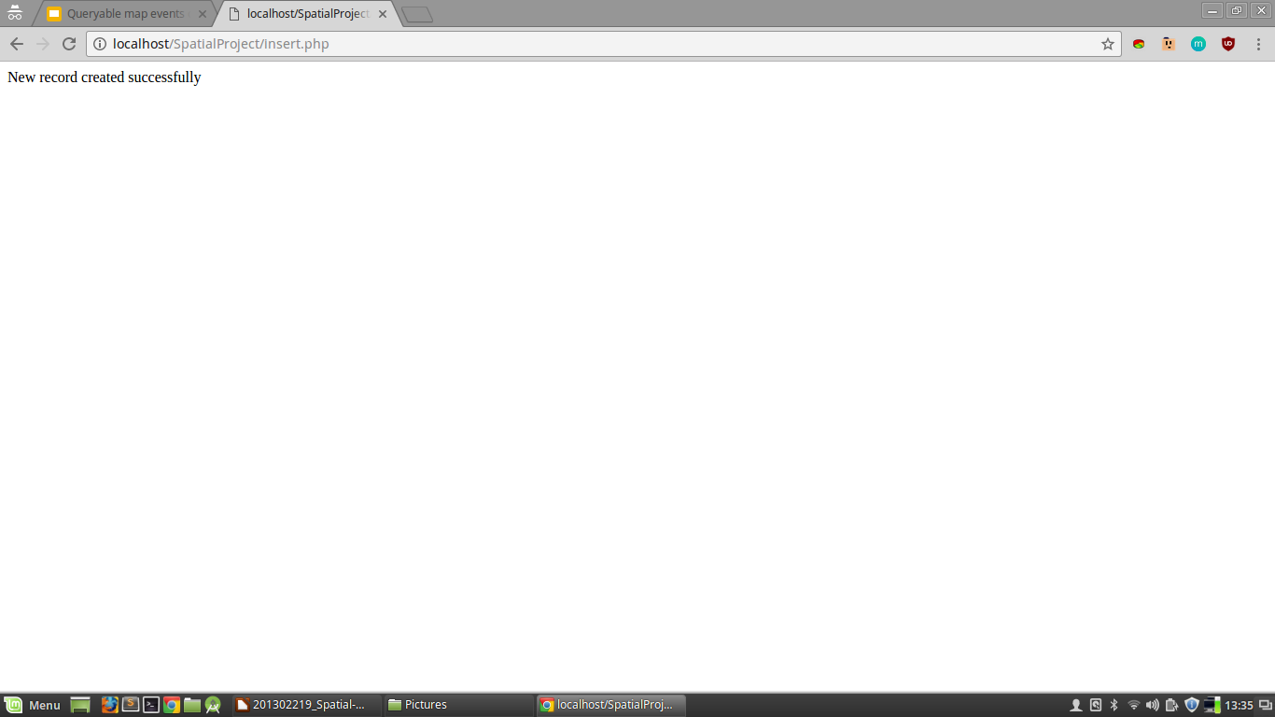

Slide 39
Thank you

